Slide 1
Who benefits from racial inequality? Monopsony with black and white workers
Michael Reich, Denis Sosinskiy, Natania Wong
Minimum Wage and Monopsony Power Conference
UC Berkeley, June 6, 2025

Slide 2
Motivating questions
Why does racial inequality persist when
Market forces should equalize pay differences among similar workers
The 1964 Civil Rights Act banned wage & employment discrimination
The 1965 Voting Rights Act gave blacks full voting rights
Do policies to support racial equality hurt white workers?
And cause backlash
Cui bono provides possible insights
We look at who benefits through the lens of frictional labor market models

Slide 3
Who benefits from racial inequality?
Two long-standing views
Human capital: No one benefits when black capabilities are under-utilized
Hsieh et al. 2019
Original sin of slavery => racial capitalism & enduring white privilege
NY Times’ 1619 Project
But institutions change
Craft unions no longer limit entry by race: Hill 1965
Industrial unions: Racial divisions benefit employers & weaken unions
AFL-CIO’s Race & Class Project
Civil rights laws in 1960s banned wage & employment discrimination
Electoral politics: “Dog whistle” politics divides Democrats, helps Republicans win elections (Haney Lopez 2013; McGee, Sum of Us, 2021)

Slide 4
I have addressed these questions before
Dissertation, “Racial Inequality and the White Income Distribution” 1974
“The Distribution of Benefits from Racial Inequality,” JHR 1978
Racial Inequality: a Political-Economic Perspective (Princeton UP 1981)
“Economic Impacts of Racism on White Americans in the Age of Trump,” in Austin & Bowser eds. 2021
This time, I use a novel monopsony model

Slide 5
Outline
Three monopsony models: three wage markdowns
Labor supply elasticity in benchmark model: 2.6
Institutions:
No wage or employment discrimination for entry level jobs
But racial inequality in career ladders, work environment, wealth, residential location, UI benefits, etc.
=> racial differences in labor supply elasticities
Estimates of racial differences in mobility: SHED & QWI
Estimates of additional wage markdowns with racial inequality
Conclusions & next steps

Slide 6
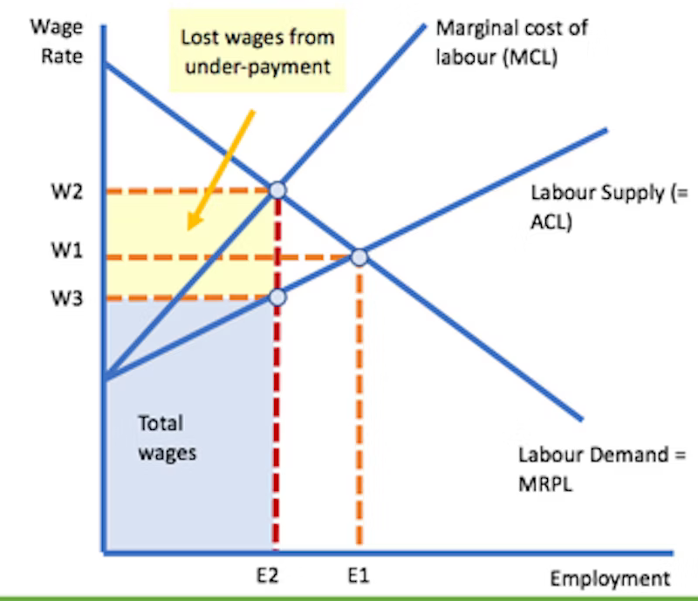
Baseline monopsony model: one type of worker
Limits on worker mobility =>
Upward sloping LS
Elasticity = eta = 2.6 (QWI)
w < MP
Mu = eta/(1+ eta) = .72
Markdown = 1 – mu = .28

Slide 7
Two monopsony models-- with two types of workers
Standard dual labor market model (Robinson 1933; Reich 1981)
Group with fewer outside options has less elastic LS
This group is paid a lower wage than the other group
Monopsony model with modern institutions
Laws ban wage & employment discrimination
But fewer outside options for one group (Naidu et al., 2016; Amior & Manning 2022)
Overall LS elasticity = weighted average of each group’s elasticity
=> greater wage markdown for both groups of workers

Slide 8
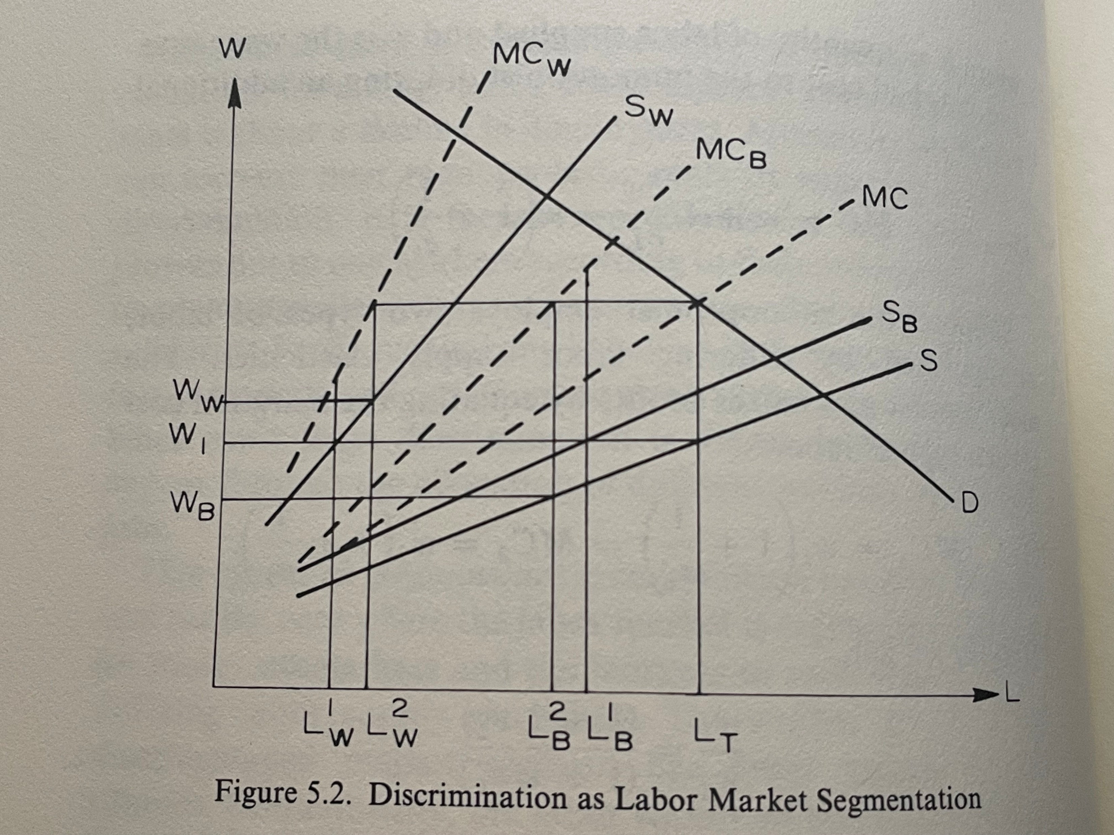
Standard monopsony model with unequal labor supply elasticities (Reich 1981)

Slide 9
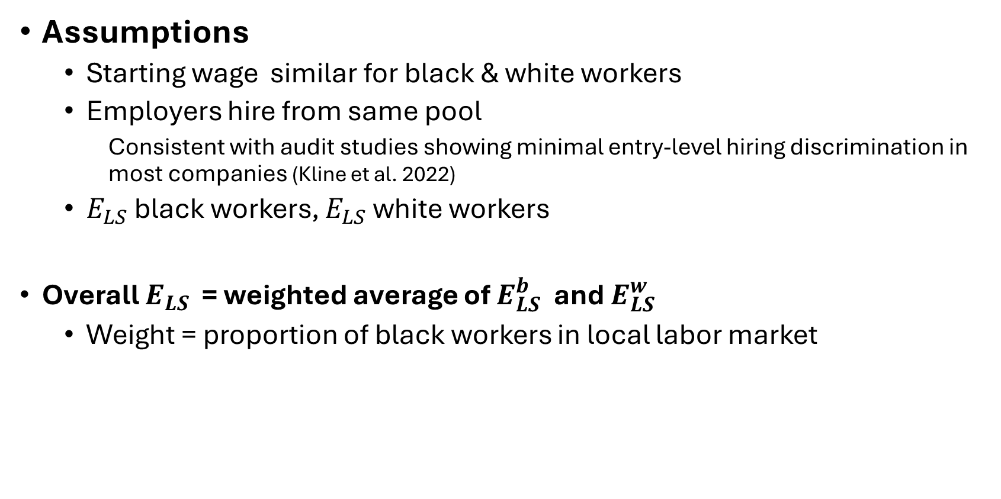
Modern monopsony model with black & white workers
Assumptions
Starting wage similar for black & white workers
Employers hire from same pool
Consistent with audit studies showing minimal entry-level hiring discrimination in most companies (Kline et al. 2022)
$E_{LS}$ black workers, $E_{LS}$ white workers
Overall $E_{LS}$ = weighted average of $E_{LS}^{b}$ and $E_{LS}^{w}$
Weight = proportion of black workers in local labor market

Slide 10
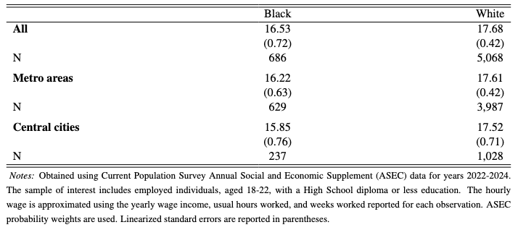
Equal pay for equal work Hourly wage by race, young workers (CPS)

Slide 11
Some sources of lower $E_{LS}$ for black workers
Lower job ladders for black workers in segmented labor markets
(Reich et al. 1973; Sahin & Tasci 2024)
Differences in savings for emergencies, financial wealth, homeownership rates (Derenoncourt et al. 2024)
Lower UI benefits (Skandalis et al. 2022)
Black workers less likely to own cars (Wursten & Reich 2023)
Non-wage disamenities
Racial issues with co-workers, supervisors, managers, customers (Zhang 2023)
Requires more job search

Slide 12
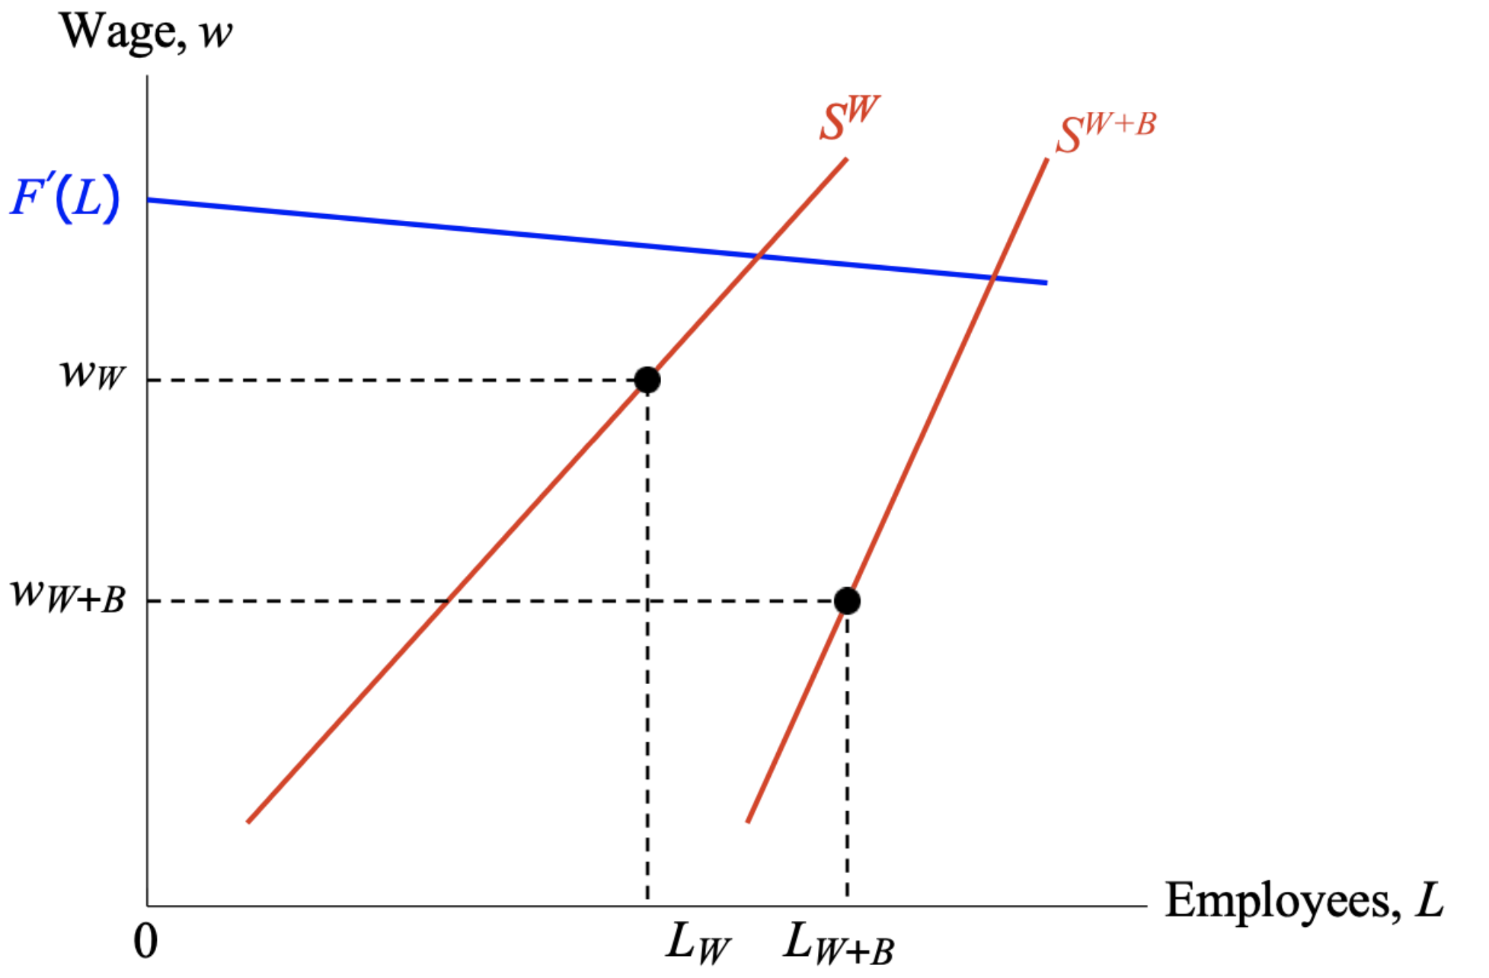
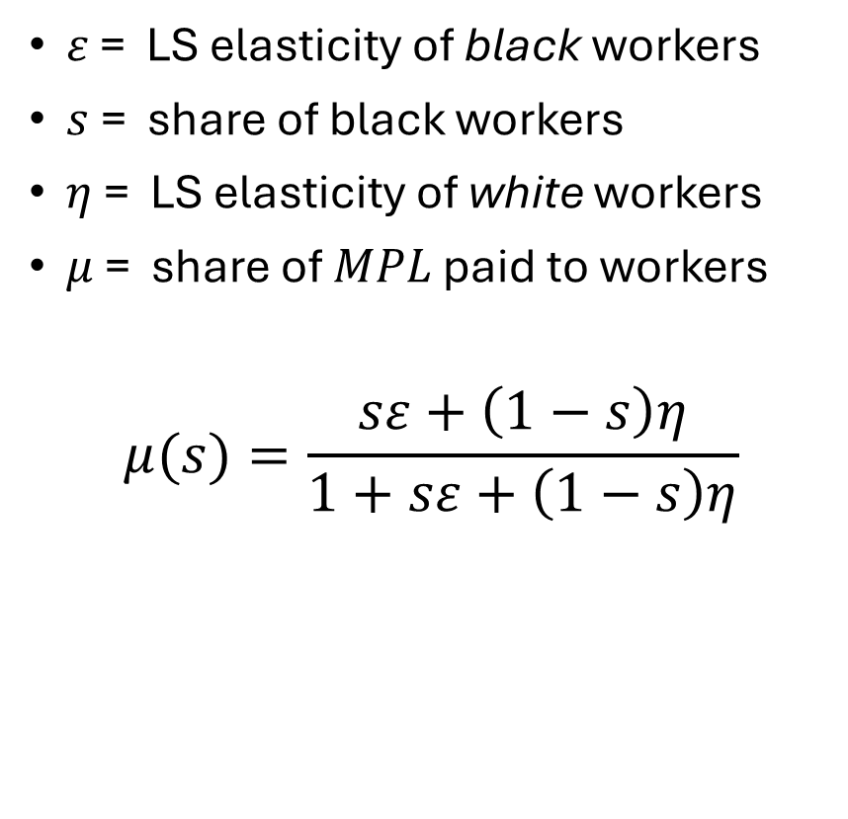
Modern monopsony model: black & white workers
$ε$ = LS elasticity of black workers
$s$= share of black workers
$η$ = LS elasticity of white workers
$μ$ = share of $MPL$ paid to workers
$$μ(s)=\frac{sε+\left(1−s\right)η}{1+sε+\left(1−s\right)η}$$

Slide 13

Next: Evidence on racial diffs in $E_{LS}$
SHED– Discrete choice experiment, hypothetical wage cuts
QWI– Separation rates among restaurant workers
SCE– Reservation wage survey question
Carr & Naidu (2022): similar results using SIPP

Slide 14
SHED Discrete choice experiments
SHED—FRB’s Survey of Household Economics & Decisionmaking
Question: “How likely would you be to actively look for another job or leave your job if your employer decreased your pay by X percent?”
Wage cut, X, is randomized: takes values of 0 (the same pay for a year), 1%, 5%, or 10%
Responses: ”Very likely”, “Somewhat likely”, “Not that likely”, “Not at all likely”
Estimation: logit probability model for effect of race
Controls: age, gender, ethnicity, household income, education

Slide 15
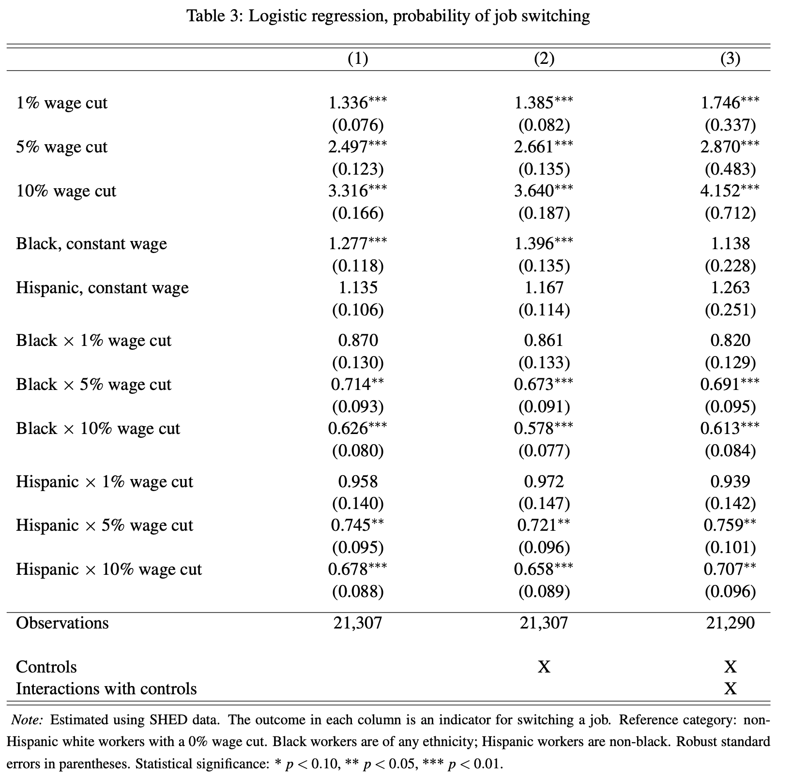
SHED: Logistic regression, pr(job switching), all workers

Slide 16
SHED Logistic regressions, pr(job switching), black workers

Slide 17
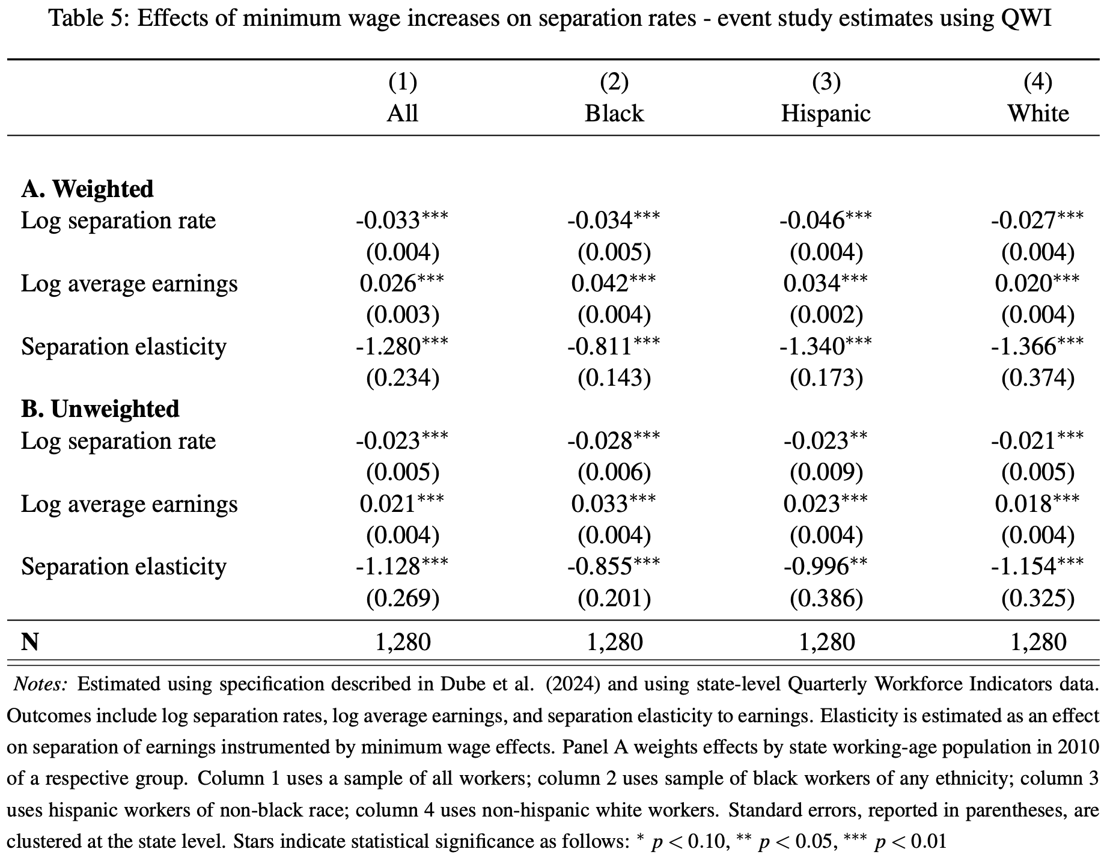
QWI: Minimum wage effects on separations

Slide 18
Wage markdowns with racial inequality
Principal city | Black proportion | Wage markdown
U.S. | 0.138 | 0.282
Atlanta | 0.469 | 0.314
District of Columbia | 0.444 | 0.311
Philadelphia | 0.399 | 0.307
Chicago | 0.284 | 0.295
Dallas | 0.237 | 0.291
Houston | 0.229 | 0.290
New York City | 0.227 | 0.290
Miami | 0.137 | 0.282
Los Angeles | 0.085 | 0.277
Phoenix | 0.078 | 0.277
U.S. & principal cities of 10 largest metros, ranked by black proportion of population

Slide 19
Wage markdowns with racial inequality U.S. & 10 states with highest black proportion of population
States | Black proportion | Wage markdown
U.S. | 0.138 | 0.282
District of Columbia | 0.409 | 0.308
Mississippi | 0.356 | 0.302
Georgia | 0.308 | 0.298
Louisiana | 0.303 | 0.297
Maryland | 0.292 | 0.296
Alabama | 0.254 | 0.292
South Carolina | 0.244 | 0.291
Delaware | 0.225 | 0.290
North Carolina | 0.201 | 0.287
Virginia | 0.184 | 0.286

Slide 20
Conclusion & implications
Racial inequality
Reduces pay of white workers
Increases employer rent
Policy & political economy implication
Policies that improve racial equality (higher MWs, improved UI benefits, affirmative action, etc.) also benefit white workers!
Basis for political coalitions for such policies

Slide 21
Next steps?
Estimate labor supply elasticities by regions, states, metros
Examine if additional wage markdowns because of race can explain wage differentials
Use cross-sectional variation in wages & in model parameters
Use MW changes to identify causal effects

