Slide 1

Taking stock of the first decade of regulating pay for gig passenger drivers James A. Parrott, PhD Center for New York City Affairs at The New School JamesParrott@newschool.edu www.centernyc.org/economic-policy Minimum Wage and Monopsony Power Michael Reich Conference University of California, Berkeley June 6, 2025
James A. Parrott, PhD
Director of Economic and Fiscal Policies
Center for New York City Affairs
New School University
JamesParrott@newschool.edu

Slide 2
Overview
Rideshare (or Transportation Network Company, TNC) drivers are independent contractors w/o employee labor standard or safety net protections, or the right to collectively bargain.
Duopsonistic TNC labor market: labor pool w/ limited employment options and high degree of management control over pay and access to work.
After a decade in which TNCs have largely saturated large urban markets, what is the status of regulating pay and working conditions?
Short answer: effective regulation has been limited and there are substantial obstacles to improving pay for many drivers.

Slide 3
Collaborators
Extensive collaboration with Michael Reich on government-contracted driver pay standard studies
New York City, 2017-18 and since
Seattle, 2019-20
Minnesota, 2023-24
Collaboration with Dmitri Koustas and Xingxing Yang on TNC data analysis
Conversations with driver organizations/supporters and government policy-makers in several states

Slide 4
Backdrop
Over 5 million online platform gig workers with 85%+ concentrated in passenger transportation services or food delivery (Garin et.al., 2023)
Defining feature of online platform work is workers’ status as independent contractors.
Uber and Lyft duopoly dominates the transp. network company (TNC) industry.
With large network scale, companies flood the streets w/ vehicles to compete by keeping passenger wait times low. Since TNCs only pay drivers when they transport passengers and with labor supply now often exceeding consumer demand
=> drivers receive low hourly pay, no benefits, & limited expense reimbursement

Slide 5
TNC driver labor market
Duopsony
Driver demographics: non-college educated male, heavily immigrant
E.g., in MN, relative to all workers, drivers are 91% male (vs. 48%); 79% not college-educated (vs. 57%), 61% foreign-born (vs. 11%)
Disproportionately SNAP recipients and either receiving Medicaid or uninsured
Drivers provide own vehicles and cover all vehicle costs; drivers providing bulk of trips often purchase cars to earn a living as TNC drivers
Algorithmic management, pay setting and control over access to work

Slide 6
Convention for denoting three TNC time segments
Period 1 (P1) = time when driver is logged into the app waiting for a dispatch, including returning from the previous destination to a busier area;
Period 2 (P2) = time when driver is on their way to pick up a passenger after accepting a ride offer; and
Period 3 (P3) = time when a driver is transporting a passenger from pick-up to drop-off.
Total working, or on-app, time = P1+P2+P3
Total miles = miles driven during P1+P2+P3
Utilization rate: P3/ (P1+P2+P3), share of on-app time with a passenger in the vehicle

Slide 7
Regulating driver pay—three core components
Per passenger (or trip) minute to compensate driver’s time
Per passenger (or trip) mile to cover vehicle expenses
Utilization factor (static or dynamic) to scale up trip time & distance for all working time and miles
In NYC standard, having utilization in the denominator intended to incentive TNCs to limit driver supply

Slide 8
Contested terrain – different approaches to pay regulations
Independent pay standards—driven by legislative and regulatory frameworks shaped by pressure from drivers
NYC 2019
Seattle 2021
Minnesota 2024
TNC-influenced pay standards—TNCs bankroll state ballot initiatives or threaten to do so
California Proposition 22 (2021)
Washington State outside of Seattle (2023)
Massachusetts (2024)
New York State outside of NYC (2024)

Slide 9
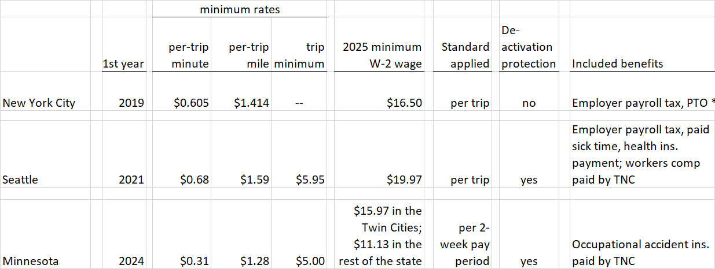
Independent pay standards, 2025 rates

Slide 10
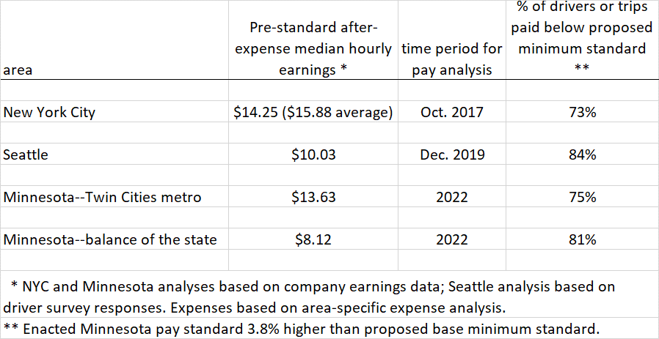
Pre-policy sub-minimum pay in independent pay standard areas

Slide 11
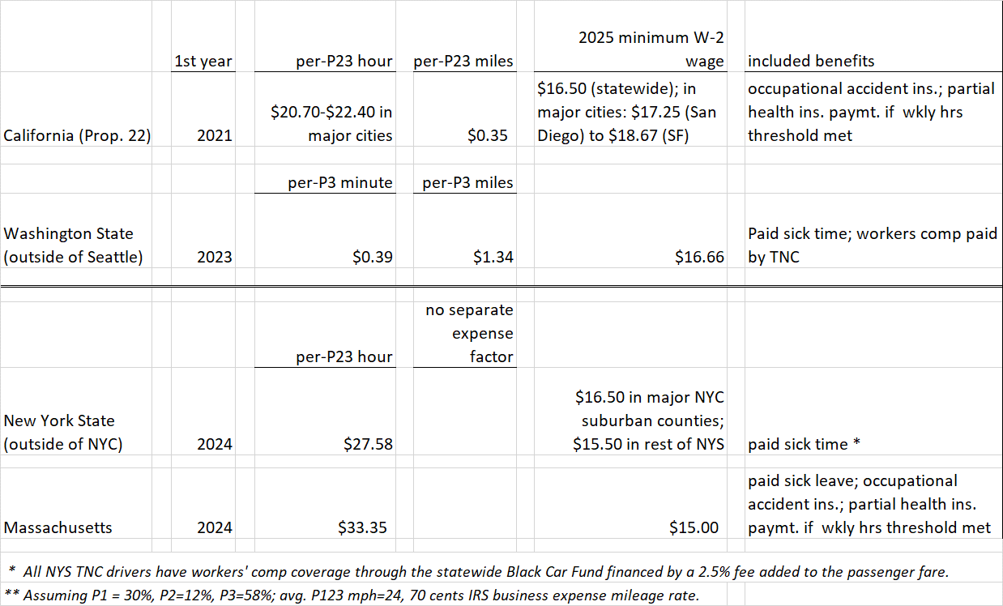
TNC-influenced pay standards, 2025 rates

Slide 12
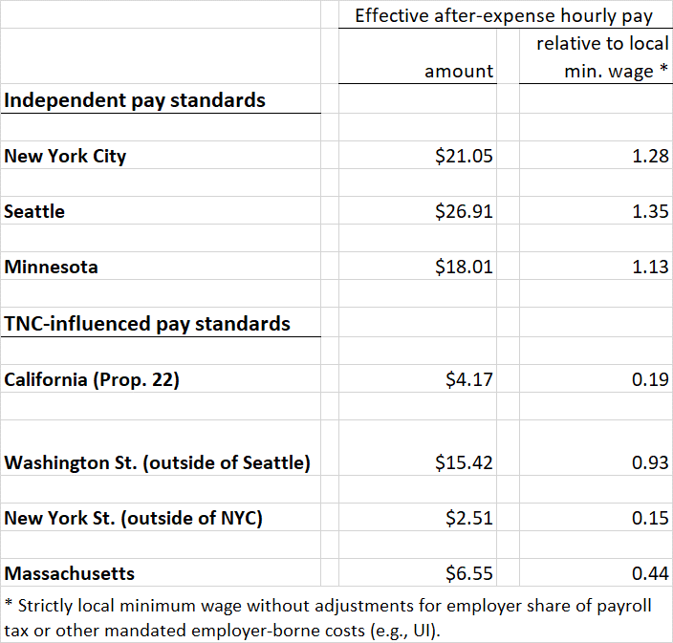
After-expense hourly pay under seven TNC driver pay standards

Slide 13
Current regulatory landscape
Data transparency, including driver on-app time and passenger fare amounts
Expenses, including for EVs
Update utilization measures, particularly given market saturation
Deactivation and lockout restrictions
Limiting supply of drivers to maintain earnings
Algorithmic pay setting
Unionization

Slide 14
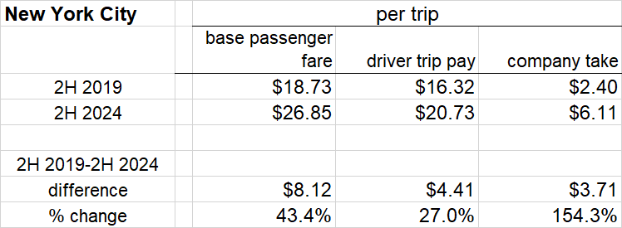
What’s the relation between NYC driver pay and passenger fares?

Slide 15
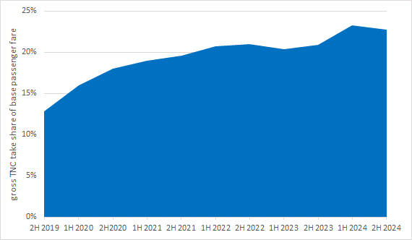
Trend in NYC TNC take rates, 2019-24

Slide 16
Conclusions
Workers remain independent contractors with few of the usual employee protections.
TNCs exercise algorithmic management and pay-setting, controlling pay and access to work opportunities.
After-expense hourly pay superior under 3 independent pay standards vs. the 4 TNC-influenced pay standards (that don’t pay for wait time).
TNCs seek to expand labor supply w/o limit to drive down pay; use algorithmic pay-setting to reduce pay offers, find drivers’ reservation wages and punish driver who reject low pay offers.
In NYC, TNC gross take rising much faster than driver pay; take rate up 10 ppts 2019-2024. Rider demand has continued to recover (now back to 92% vs. 2019), demand strong in more price-sensitive outer boros.

Slide 17
Appendix slides—2 slides on delivery worker pay, and additional detail on TNC challenges

Slide 18
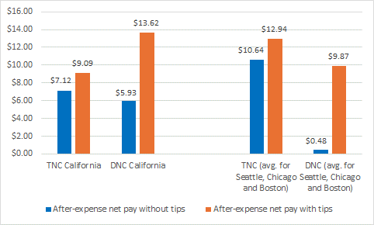
After-expense hourly pay for TNC drivers greater than for DNC workers but tips higher for DNC workers, 2022
Source: Jacobs, Reich, Challenor and Farmand, Gig Passenger and Delivery Driver Pay in Five Metro Areas, UCB Labor Center, May 2024

Slide 19
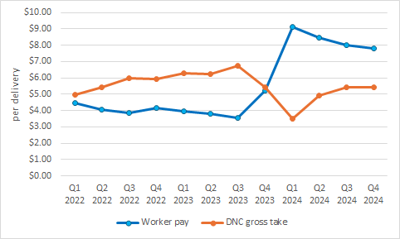
Two big takeaways from the 1st year of NYC restaurant delivery worker pay standard
Pay per delivery has doubled (from $4 to $8) since the pay standard took effect Dec. ‘23, while DNC gross take was $1 per delivery less in Q4 ‘24 vs. Q1-Q3 ’23.
However, DNCs are adapting to the standard, tightly controlling access to the app, and over course of ‘24, pay per delivery declined while gross take quickly recovered back to early ‘22 levels.

Slide 20
NYC lockouts and TLC-proposed restrictions
To incentivize TNCs to self-regulate driver supply in light of consumer demand, original pay standard put utilization rate (UR) in the per minute and per mile pay components.
TLC didn’t adjust UR until main drivers’ group pushed for updating beginning in 2023 (UR had fallen from 0.58 to 0.53-0.54 range).
To manipulate measured UR in 2024, TNCs began logging drivers off in the middle of a shift or preventing log-on.
Press coverage of hardships drivers experienced from lockouts; Bloomberg reporters developed a What’sApp tip line to document lockouts, generating 5300 screenshots. https://www.bloomberg.com/graphics/2024-uber-lyft-nyc-drivers-pay-lockouts/
To restrict lockouts, TLC has proposed that the TNCs provide 72-hours’ notice to any driver, and that once on the app, drivers not be logged off mid-shift.

Slide 21
Limiting labor supply
With TNC markets maturing, essential to regulate driver supply to prevent erosion in hourly pay.
With no built-in mechanism in new MN pay standard, and significant increase in # of drivers since base year, important to update.
NYC City Council enacted vehicle cap in 2018 but there has always been ample room under the cap for TNCs to on-board add’l drivers.
TLC added 10,500 electric vehicles to the cap
Plus, the original cap allowed fleet owners to rent vehicles at a premium.

Slide 22
Algorithmic pay-setting
TNCs leverage their algorithms and the behavioral learning they make possible to individually determine trip and pay offers for drivers, factoring in not only usual supply and demand conditions but also an ability to approximate a driver’s reservation wage.
Veena Dubal labeled this “algorithmic wage discrimination”.
Where driver density permits, TNCs “auction” off ride offers to the lowest bidder.
Where drivers can see “up-front” pay offers, ride rejection rates can be very high.
In our MN driver survey, 23% of drivers rejected 20% or more of trip offers andanother 28% rejected offers 5-20% of the time.
So far, the effects of algorithmic pay-setting can be limited only by minimum pay standards implemented on a trip basis.

Slide 23
TNC driver unionization
To date, the TNCs have fought back all attempts seeking to classify drivers as W-2 employees.
Limited # of drivers covered by independent pay standards, and all protections and benefits have been established piecemeal through legislation or legal settlements.
In a first, MA voters in 2024 passed a ballot initiative giving TNC drivers the right to unionize and negotiate for better pay, benefits and working conditions.
The App Drivers Union, backed by 32BJ SEIU and the Machinists, have begun collecting authorization cards.
Drivers in Chicago (SEIU-Machinists) and in Minnesota (SEIU) seeking State legislation allowing drivers to unionize.

Slide 24
Non-compliance with various regulations
FTC 2017 $20 million Uber settlement regarding misleading drivers regarding their earnings potential
NY AG 2023 $328 million Uber & Lyft wage theft settlement
Uber 2023 NY DOL UI payroll tax settlement (retroactive to 2014, amount not publicly reported but likely about $0.5 billion)
Uber and Lyft 2024 $175 million Massachusetts AG back-pay agreement
Ongoing $1B+ California suit by cities and others regarding pre-Prop 22 pay violations (vs. Uber, DoorDash and others)

Slide 25

Thank you.
James Parrott
Center for New York City Affairs
at The New School
jamesparrott@newschool.edu
www.centernyc.org/economic-policy
www.centernyc.org

